Slide 1
SPANviewer - A Visualization Tool
for Advanced Robotics Applications
Stefan Kimmer
16/05/2013

Slide 2
Outline
SPANviewer | Stefan Kimmer | ESA Telerobotics and Haptics Laboratory

Slide 3
Outline
Motivation
Software – Architecture and Concepts
Current Applications
Conclusion

Slide 4
Motivation and Requirements
SPANviewer | Stefan Kimmer | ESA Telerobotics and Haptics Laboratory

Slide 5
Motivation and Requirements
Motivation
Generic viewer for serial and parallel robotics
Requirements
Cross platform
Conventions as commonly used in robotics, e.g.:
Denavit-Hartenberg parameters
Frames (Position + Euler angles)
Quick debugging and analysis of control algorithms
E.g. Quick configurable communication
Overlay of virtual robotic structures in video streams
Stereoscopic (3D) visualization for passive stereoscopic displays

Slide 6
Motivation and Requirements
Requirements
Requirements
Integration in the Space Portable Applications Network (SPAN)
SPAN: developed at ESA
=> SPANviewer

Slide 7
Software
Architecture and Concepts

Slide 8
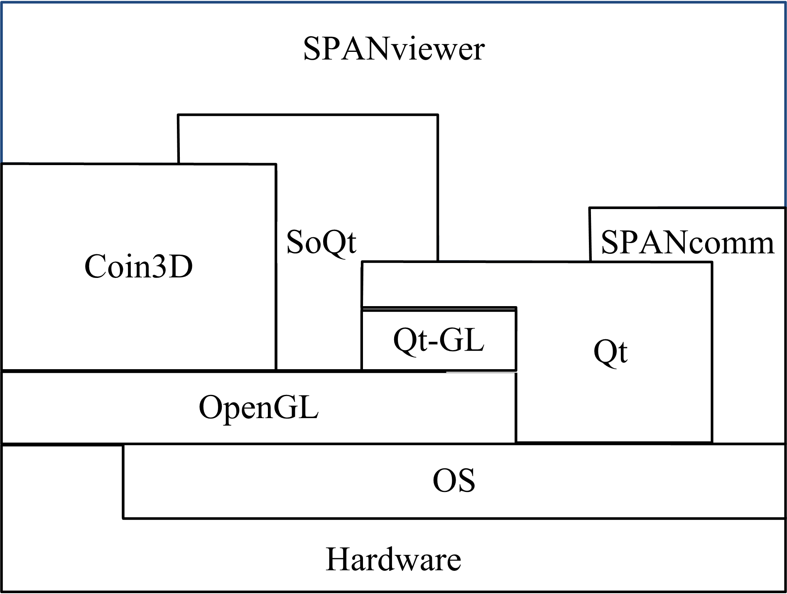
Software Architecture and Concepts
Software Architecture
Built on top of open source libraries
All libraries are cross platform
Written in C++
The SPANcomm library: for inclusion in the SPAN tool chain

Slide 9
Software Architecture and Concepts
Software Concepts
One XML file as input which contains definitions for a world
The world contains definitions for a scene
In the scene robotic structures and other objects can be defined
The XML file can define which parts can be controlled by a communication interface
A camera (viewpoint) or multiple cameras can be defined
Communication through UDP messages and shared memory
Without the need of a custom protocol

Slide 10
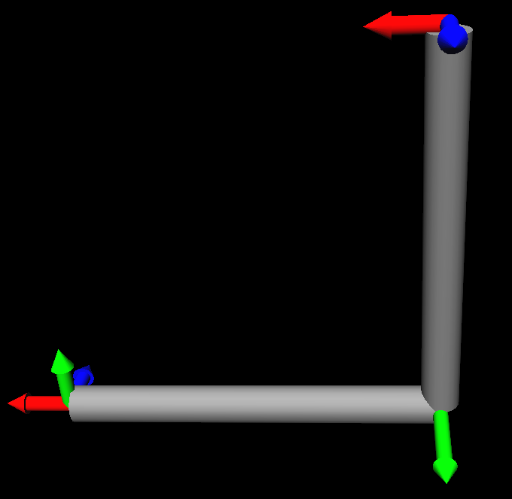
Software Architecture and Concepts
Sotware Concepts – the XML file
Input
One XML file as input
World as root element
Scene Definition
Robotics structures
E.g.: Parallel structure
<?xml version="1.0"?>
<world xmlns="ESA-Telerobotics-Lab-SPAN">
<scene units="0.2">
<structure convention="dh">
<joint d="0.5“ theta=“0” a="0" alpha="-1.5708" />
<joint d="0“ theta=“0” a="0.5" alpha="1.5708" />
</structure>
</scene>
</world>
=> Denavit-Hartenberg parameters: d, $θ$, a, $α$

Slide 11
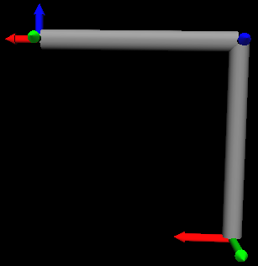
Software Architecture and Concepts
Sotware Concepts – the XML file
Scene Definition
Series structure
The hierarchical nature of the XML allows straight forward kinematic chaining
<?xml version="1.0"?>
<world xmlns="ESA-Telerobotics-Lab-SPAN">
<scene units="0.2">
<structure convention="dh">
<joint d="0.5“ a="0" alpha="-1.5708" >
<joint d="0“ a="0.5" alpha="1.5708" />
</joint>
</structure>
</scene>
</world>

Slide 12
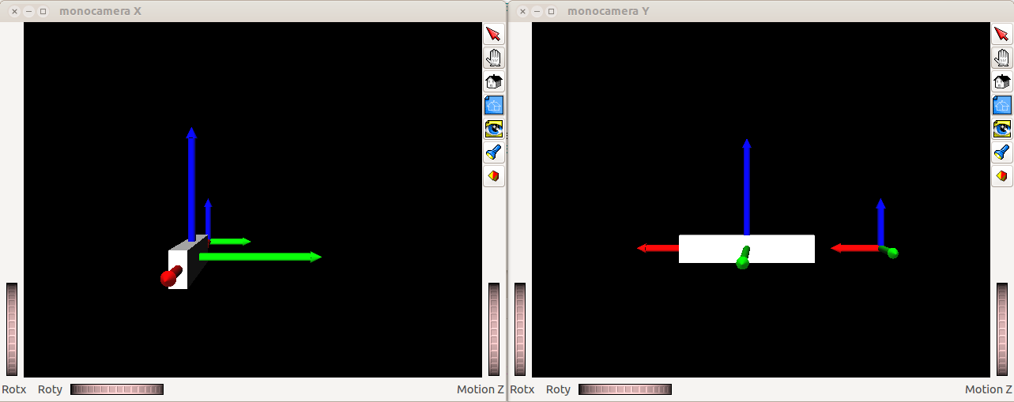
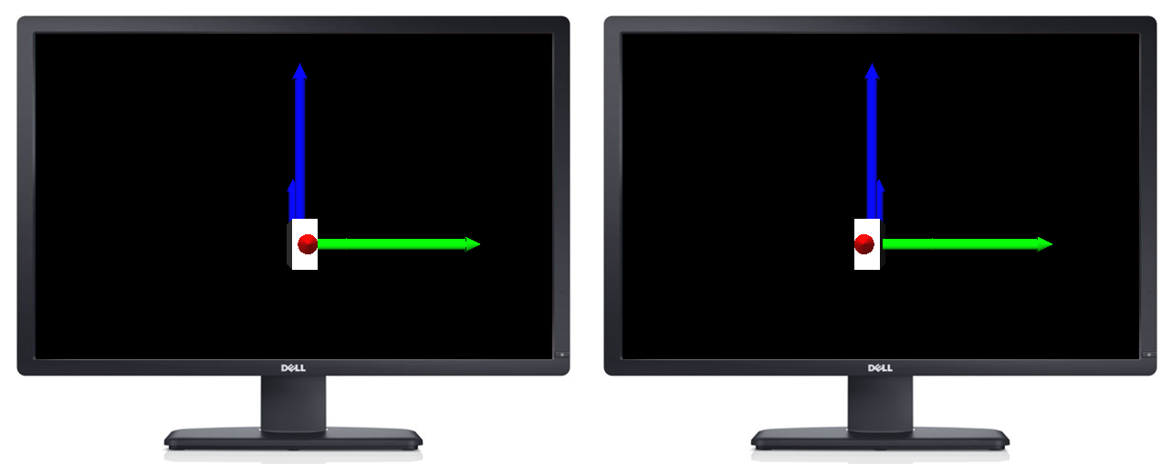
Software Architecture and Concepts
Sotware Concepts – the XML file
Camera
Defines a view point
Opens a separate window
<?xml version="1.0"?>
<world xmlns="ESA-Telerobotics-Lab-SPAN">
<camera>
<monocamera window_title="monocamera X">
<pose x="100" y="0" />
</monocamera>
<monocamera window_title="monocamera Y">
<pose x="0" y="100" />
</monocamera>
<stereocamera>
<pose x="700" z="200" z="0" />
<screendef diameter="1016" />
</stereocamera>
</camera>
<scene units="100">
<cube sx="100" sy="10" sz="20" tx="200“>
</scene>
</world>

Slide 13
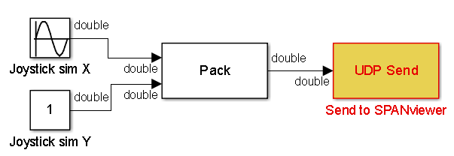
Software Architecture and Concepts
Sotware Concepts – Coomunication
Communication model
Low level Protocols: UDP or Shared Memory
Each object can use a different channel
Sending joint values to the structure with Simulink:
xml.xml
<?xml version="1.0"?>
<world xmlns="ESA-Telerobotics-Lab-SPAN">
<scene>
<structure convention="dh" channel=“2">
<joint a="10" alpha="0">
<joint a="20" alpha="1.5708" />
</joint>
</structure>
<cube channel=“1"/>
</scene>
</world>
Port 25000
Sending position values to the cube with Python:
import socket, struct
sock = socket.socket(socket.AF_INET, socket.SOCK_DGRAM)
sock.sendto(struct.pack("ddd", 11, 12, 0), ("127.0.0.1", 25001))
Command line execution:
> spanviewer --input xml.xml --channel 25001 25000

Slide 14
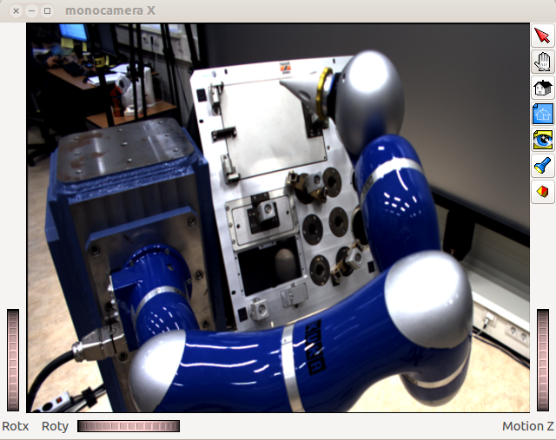
Software Architecture and Concepts
Sotware Concepts – Video Streams
Video Streams
Embedded as
Image in the scene
Background image
Send to it via an image channel
Output
xml.xml
<?xml version="1.0"?>
<world xmlns="ESA-Telerobotics-Lab-SPAN">
<scene>
<backgroundimage resx="1920" resy="1080" channel=“1” />
</scene>
</world>
Command line to launch a stream of camera video with GStreamer to the SPANviewer:
> gst-launch autovideosrc ! ffmpegcolorspace ! video/x-raw-rgb, width=1920, height=1080, bpp=24 ! shmsink shmkey=Overlay
Command line execution:
> spanviewer --input xml.xml --img-channel Overlay

Slide 15
Current Applications

Slide 16
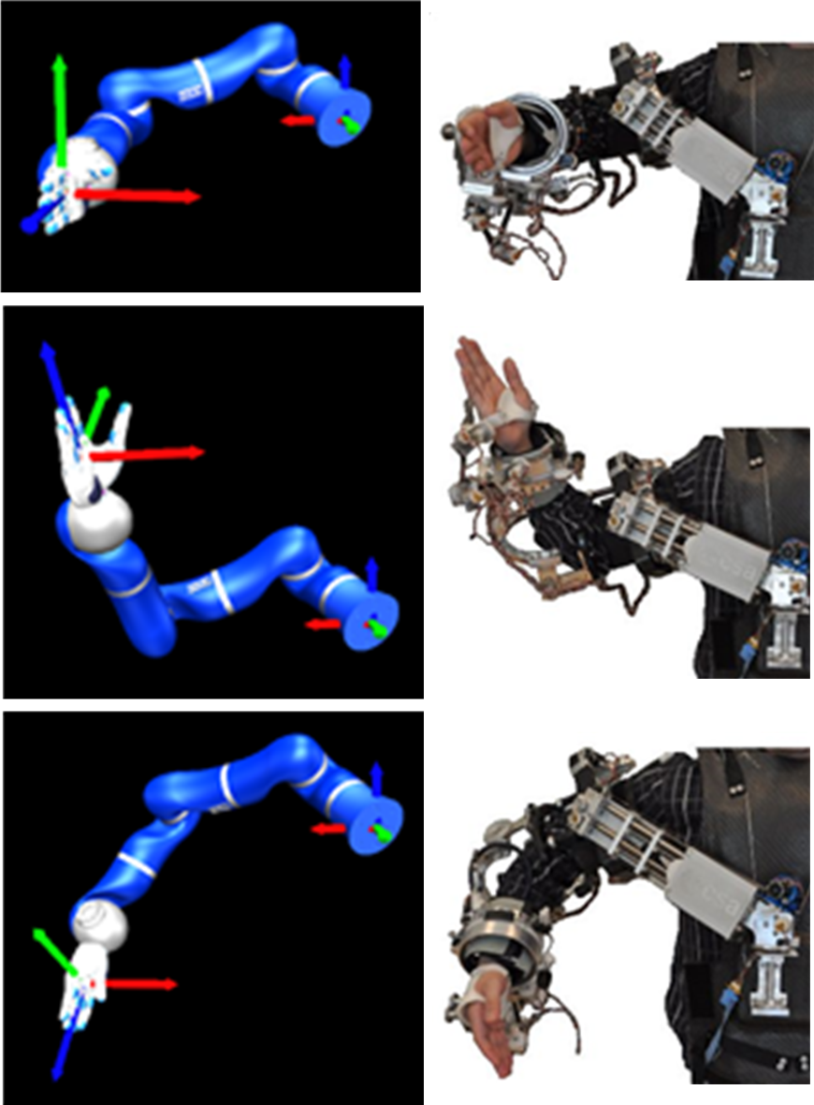
Current Applications
Kinematic Studies
Controlling a simulation of the KUKA light weight robot with 7 joints by an exoskeleton
Enables the study of kinematic mapping
Elbow control algorithms can be analyzed

Slide 17
Current Applications
Kinematic Studies

Slide 18
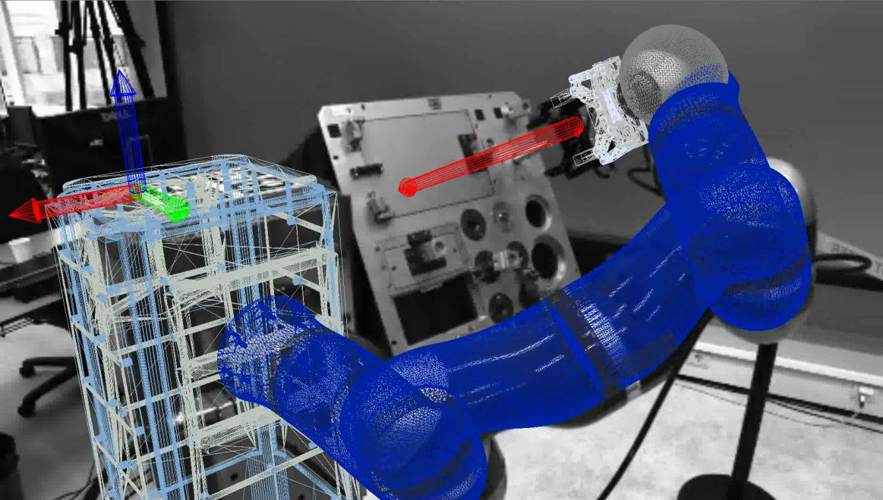
Current Applications
Overlay of Video Streams
Virtual overlay for enhancing situational awareness
Internal camera parameters can be configured
External camera parameters can be sent in real time

Slide 19
Current Applications
Overlay of Video Streams

Slide 20
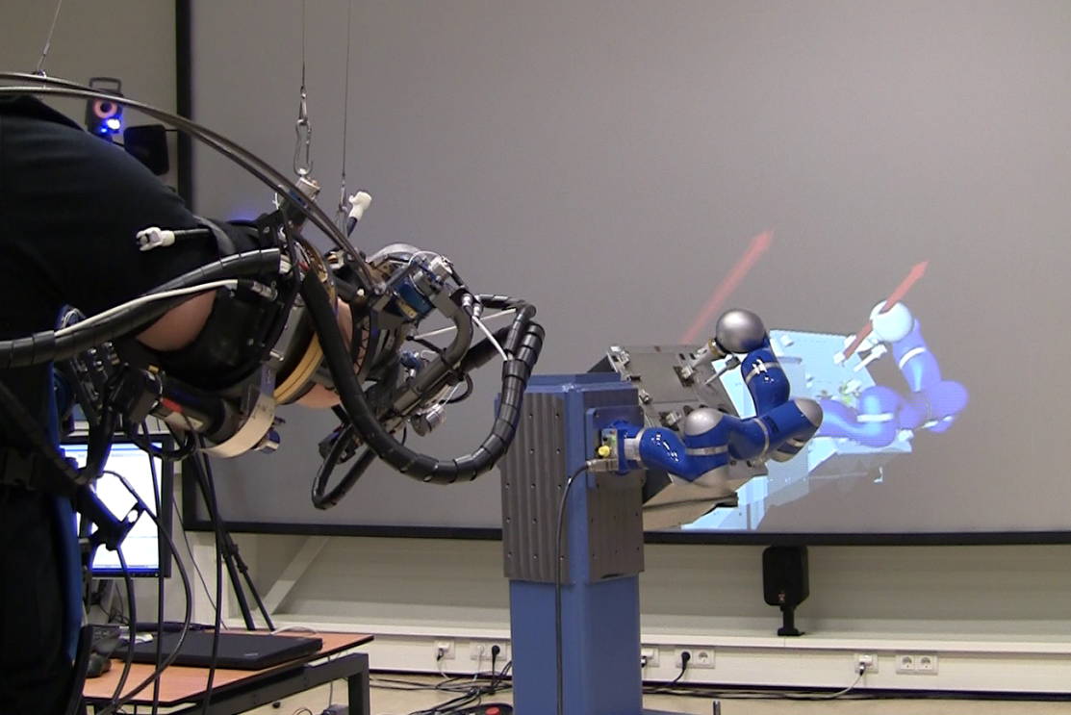
Current Applications
Stereoscopic Augmented Reality
Enhancing Situational awareness
Visualizing a force vector at the point of exertion at the real robot
View point adaption for the operator

Slide 21
Current Applications
Stereoscopic Augmented Reality

Slide 22
Conclusions

Slide 23
Conclusions
SPANviewer fully implemented and tested
Easily adaptable modeling
Used as a debugging tool
Variety of applications in the Telerobotics and Haptics Lab
Easy deployment
Working on different OS (Linux PC, Windows both PC and tablet)
End-user installer/package

Slide 24
Thank you!
Questions?
SPANviewer – A Visualization Tool for Advanced Robotics Applications
Stefan Kimmer^{1,2,3}, João Rebelo^{1,2,3} and André Schiele^{1,2,3}
¹ E-mail: {stefan.kimmer, joao.rebelo, andre.schiele} @ esa.int
² Faculty of Mechanical, Maritime and Materials Engineering, Delft University of Technology, Delft, The Netherlands
³ Telerobotics and Haptics Laboratory, ESTEC, Noordwijk, The Netherlands

